Slide 1
Last Week
This Week
가족여행(8/12 – 8/16)
Lumerical FDTD 추가 구매 견적
CPU Workstation 구매 사양
Neural Network Model Training
8/20(화) 삼성전략산학 교류회
FDTD, New workstation 구매 진행
Neural Network Model preparation
Inverse Design coding

Slide 2
Lumerical FDTD 라이선스 추가 구매 견적
3가지 구매 방법
기존 라이선스 기간에 맞춰서 구매
갱신 날짜(10/31)까지 임대 사용 후, 2개의 라이선스를 동시에 갱신
임대 비용 (90일): 868,000 원
비용: 3,520,000 * 2* 0.9(10% 할인) = 6,336,000 원
기존 라이선스와 별도로 구매
기존 라이선스 비용: 3,520,000 원
신규 구매 비용: 3,520,000 원 (기존과 동일)
총 비용: 7,040,000 원

Slide 3
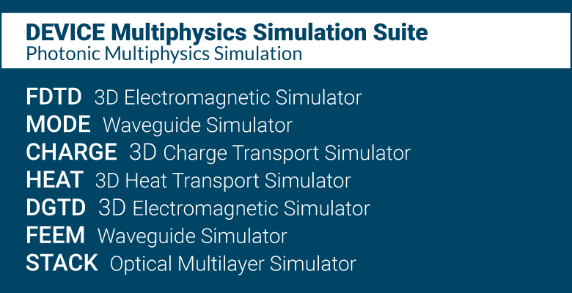
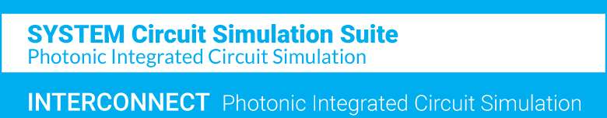
Lumerical FDTD 라이선스 추가 구매 견적
Lab Suite로 업그레이드
Lab Suite: FDTD를 포함해서 Lumerical 제품이 모두 포함된 번들 라이선스
FDTD(3), MODE(1), DGTD(1)*, CHARGE(1), HEAT(1), FEEM(1)**, INTERCONNECT(1)
라이선스 비용: 7,040,000 원
기존 라이선스 취소 후 잔여기간은 업그레이드 비용에서 공제
* DGTD: Discontinuous Galerkin Time Domain
- Higher order mesh polynomials for
accurate performance control
** FEEM: Finite Element Eigenmode
- Superior performance scaling thanks to
higher order mesh polynomials

Slide 4
CPU Workstation 구매 사양
기존 GPU Workstation은 GPU 활용을 위한 사양
CPU Workstation은 CPU 활용에 집중 (Lumerical FDTD는 GPU 지원 X)
No. | 품 명 | 사 양 (Specification)
 |  | GPU Workstation | CPU Workstation
1 | CPU | INTEL 제온 스케일러블 실버 4114 (10 core / 20 thread * 2 = 20 core / 40 thread, 2.2GHz) | INTEL 코어X-시리즈 i9-9980XE (18 core / 36 thread, 3.0 GHz)
2 | RAM | 삼성 DDR4 32GB RAM/2400MHz/ECC/REG (32GB * 12 = 384GB) | G.SKILL DDR4 16GB RAM/3600MHz (16GB * 8 = 128GB)
3 | GPU | 2 * NVIDIA GeForce RTX 2070 8GB | NVIDIA GeForce GTX 1660Ti 6GB
4 | SSD | 삼성 860 PRO Series 1TB | 삼성 970 EVO Plus M.2 1TB
5 | POWER | 80PLUS GOLD 1000W | 80PLUS PLATINUM 1000W
6 | Price | 1000만원 | 700만원
Advantages |  | 1.6GT/s faster bus transfer rate Larger maximum ram size | 2.45x faster CPU speed Higher ram speed

Slide 5
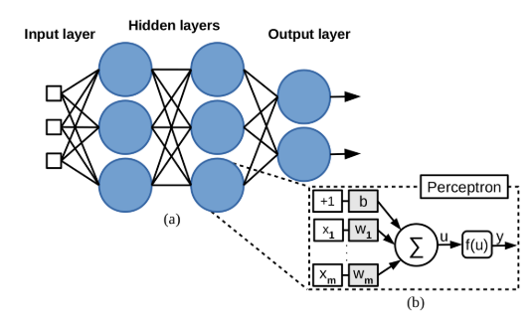


Algorithm with Neural Network
With Neural Network
FCNN (Fully Connected Neural Network)
ResNet (Residual Network)
$$f\left(x\right)=g\left(x\right)+l(x)$$
$x$: nanophotonic structure
$f\left(x\right), g(x)$: Optical response(spectrum)
FDTD
Neural
Network
loss
Forward design
Inverse design
Initial
structure
Neural
Network
Result
Structure
Optimizer
Iteration

Slide 6
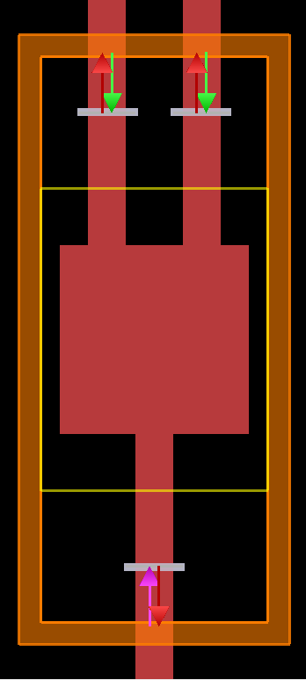
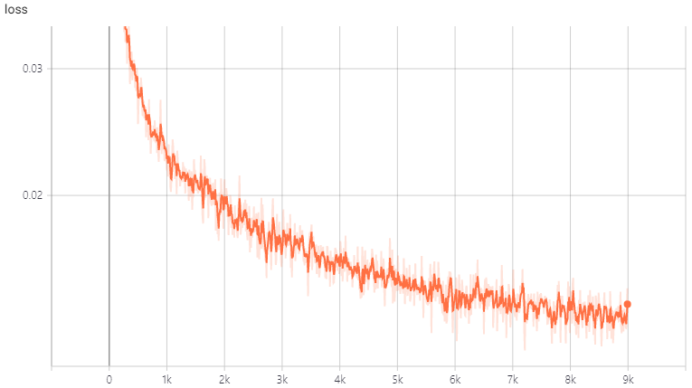
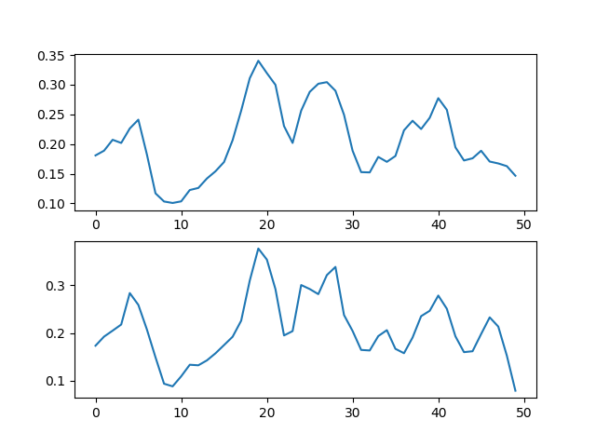
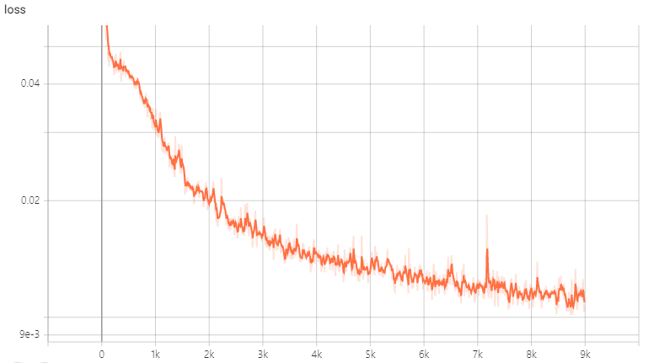
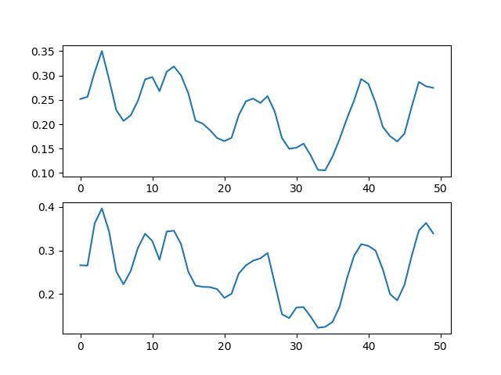


Training Result
$$f\left(x\right)=g\left(x\right)+l(x)$$
FDTD
Neural
Network
loss
$$loss= \left|f\left(x\right)−g\left(x\right)\right|$$
FCNN
Neural Network
Transmission
FDTD
~ 0.015
ResNet
Learning Step
Wavelength
Neural Network
Transmission
~ 0.010
FDTD
Learning Step
Wavelength

Slide 7
Paper Topic
1 x 2 Splitter
ResNet ref. : Mohammd H. Tahersima et al. “Deep Neural Network Inverse Design of Integrated Photonic Power Splitters,” Scientific Reports, 2019.02
CNN ref.: Mohammd H. Tahersima et al. “Nanostructured Photonic Power Splitter Design via Convolutional Neural Networks, ” in Conference on Lasers and Electro-Optics, OSA, 2019.05
1 x 3 Splitter
ML ref. : Alexander Y. Piggott et al. “Fabrication-constrained Nanophotonic inverse design,” Scientific Reports, 2017.05
Dr. Philsophy: Alexander Y. Piggott , “Automated Design of Photonic Devices,” 2018.06

Slide 8
Intro
Machine Learning and Deep Learning
Nanophotonic Structure Design Method
기존 설계 방법
Motivation: Why Machine Learning
Additive Reinforcement Learning Algorithm
1D DBR
Data Generation and Preprocessing
Power Splitter
Data Generation and Preprocessing
Inverse Design with Neural Network
1D DBR
Power Splitter
Result
References
Intro
Motivation
Machine Learning and Deep Learning
Machine Learning Methods
Additive Reinforcement Learning Algorithm
Artificial Neural Network
Fully Connected Neural Network
Residual Connected Convolutional Networks
Device Modeling
1D DBR
Data Generation and Preprocessing
ARLA approach
ANN approach
Power Splitter (2 output, 3 output)
Data Generation and Preprocessing
ARLA approach
ANN approach
Result
References

Slide 9
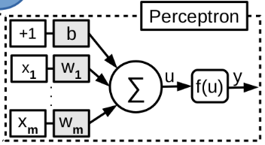
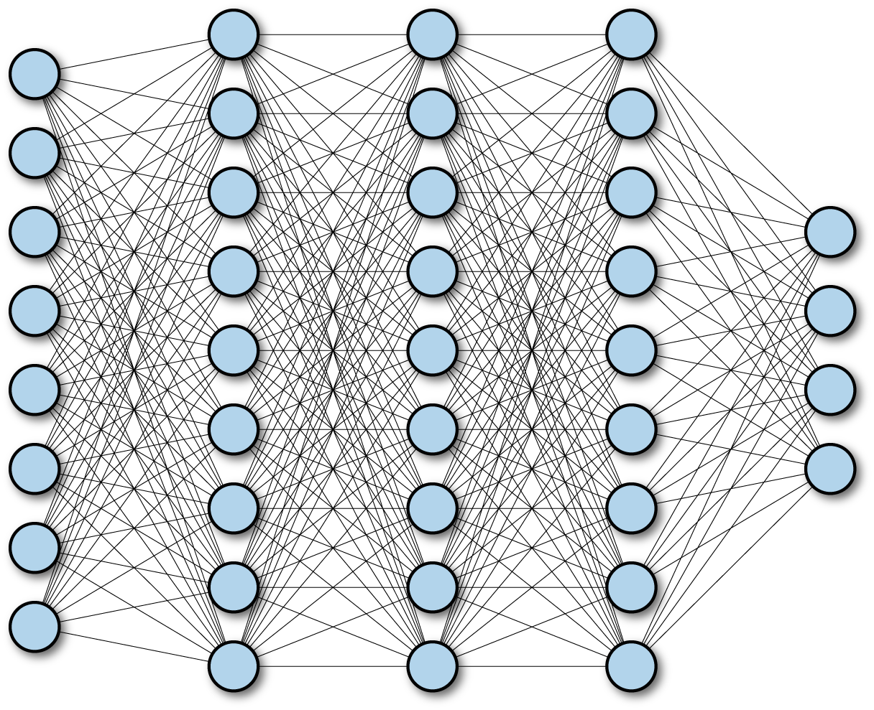
Neural Netowrk
FCNN (Fully Connected Neural Network)
Layer
Input
Output
ResNet (Residual Network)
Layer
1
Layer
2
Layer
3
Layer
4
Input
+
+
Output
DenseNet
Dense Block
Layer
1
Layer
2
Layer
3
Layer
4
Input
[+]
[+]
[+]
[+]
Output

